Slide 1


Department of Electronics & Communication Engineering
Presentation on
“A THERAPY SYSTEM FOR ARTICULATION DISORDER CORRECTION”
By
Himashree J
(4GW20EC051)
Under the guidance of
Internal Guide
Smt. Harshitha R
Assistant Professor
Dept. of ECE, GSSSIETW

Slide 2


Contents
Company Profile
About the Department
Task Performed
Introduction
Problem Statement
Block diagram
Software Requirements
Results
Reflection Notes
Conclusion
References

Slide 3
Company Profile
SaiTech Integrated Solutions: Professional outsourcing Embedded and Software Development company in Mysuru. Established in the year 2013.
Services: Software Development, IT Infrastructure, Digital Marketing, Corporate Training.
Vision: To build long term relationship with clients for providing quality training, products, implementation, services.
Mission: To nurture passionate innovators, create professionals and enhance customer trust.

Slide 4
About the Department
Departments Overview: Research and Development focus on product segments and services.
Key Departments :
Software Engineering: Specialization in designing and development of software in real-time embedded systems.
Software Testing: VnV services, white box testing, unit and integration testing, black box/system testing, GUI testing, compliance testing in various domains.

Slide 5
About the Department
Training: Specializes in departing Industry-ready training, follow integrated theory and practical approach, prepare trainee project ready and performance evaluation.

Slide 6
Task Performed
The internship consisted of the following sections:
Identifying the Domain.
Identifying the field of work system.
Study of Previous work done.
Analysis made for new Technique.

Slide 7
Project: A THERAPY SYSTEM FOR ARTICULATION DISORDER CORRECTION
Introduction
Articulation problems reduce speech intelligibility and communication. It also affects person's interpersonal communication, personality, social adaptive capability and learning ability.
Hence Therapy sessions are necessary for articulation correction. In specific it is more important for the children in the age group of 7-9 years, as it is a best time for detection and correction of articulation disorder.
The therapy sessions help children to become clear confident communicators so that they can become fully engaged in school and benefit from the curriculum, develop self help skills and independence for activities of daily living, actively participate in life experiences, and build healthy social relationships.

Slide 8
Problem statement
Articulation encompasses the physical coordination of the tongue, lips, teeth, and jaw to produce speech sounds, facilitating clear expression of basic needs through understandable words and sentences.
Articulation disorders, encompassing sound substitutions, slurred speech, or indistinct articulation, pose significant challenges in the 21st century.
Assessing and treating children with articulation disorders poses a major challenge for therapists due to the difficulty in analyzing and selecting effective correction strategies despite their clinical experience, potentially leading to unsuccessful outcomes.

Slide 9
Components
Software Requirements
MATLAB is widely used as a computational tool in science and engineering encompassing the fields of physics, chemistry, math and all engineering streams. It is used in a range of applications including:
Signal processing and Communications
Image and video Processing
Control systems
Test and measurement
Computational finance
Computational biology

Slide 10
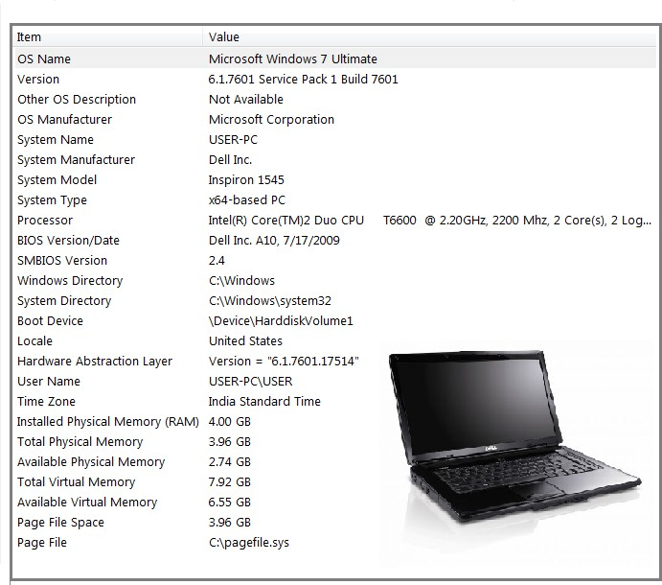
Hardware Requirements
Laptop Dell i5

Slide 11
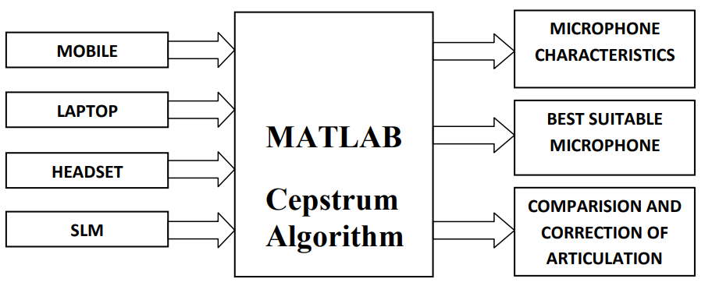
Block Diagram

Slide 12
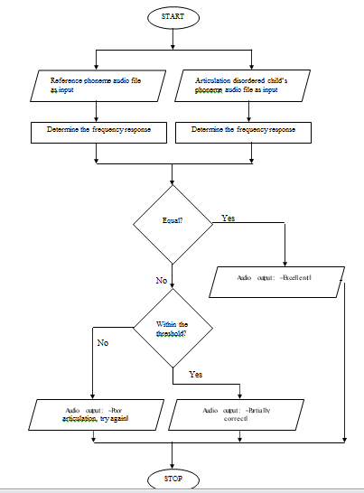
Methodology

Slide 13
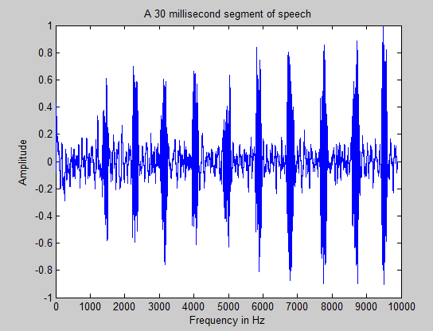
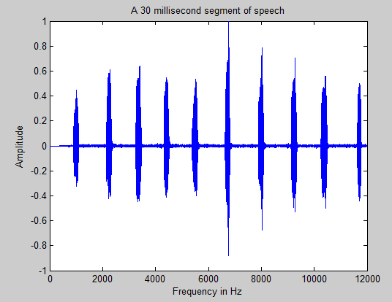
Fig 1: Laptop ( Phoneme ―a‖ ) Fig 2: Mobile ( Phoneme ―a‖

Slide 14
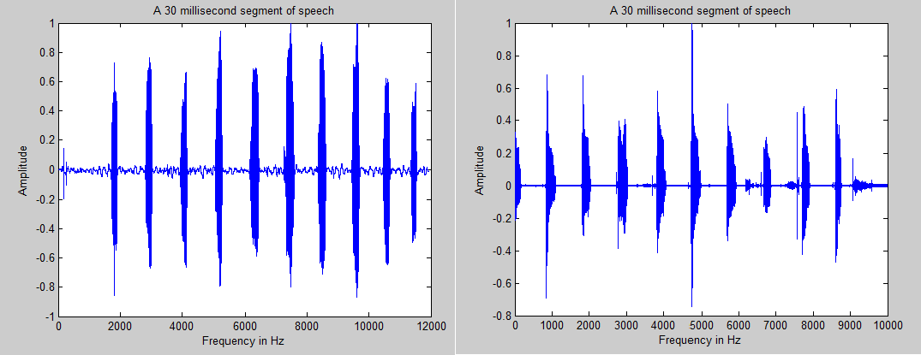
Fig 3: Headset ( Phoneme ―a‖ ) Fig 4: SLM ( Phoneme ―a‖ )

Slide 15
SI.No | PHONEMES | SI.No | PHONEMES | SI.No | PHONEMES | SI.No | PHONEMES
1. | A (ಅ) | 8. | I (ಐ) | 15. | O (ಒ) | 22. | U (ಉ)
2. | Ba (ಬ) | 9. | Ja (ಜ) | 16. | Pa (ಪ) | 23. | Va (಴)
3. | Cha (ಚ) | 10. | Ka (ಕ) | 17. | Ra (ರ) | 24. | Ya (ಯ)
4. | Da (ಡ) | 11. | La (ಲ) | 18. | Sha (ವ) | 25. | Au (ಔ)
5. | E (ಇ) | 12. | Laa (ಳ) | 19. | Sa (ಸ) | 26. | Dha(ದ)
6. | Ga (ಗ) | 13. | Ma (ಮ) | 20. | Ta (ಟ)
7. | Ha ( ಹ) | 14. | Na (ನ) | 21. | Tha (ತ)
Table 1: List of Kannada phonemes

Slide 16
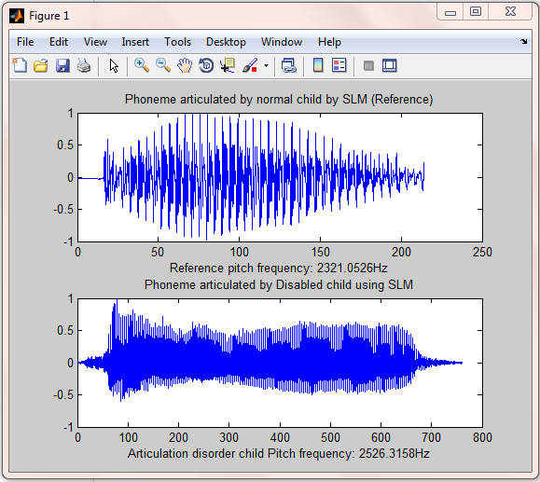
Result

Slide 17
Reflection Notes
Increased Accessibility: A therapy system could provide additional practice opportunities outside of formal therapy sessions. This could be especially helpful for individuals who live in remote areas or have limited access to a speech-language pathologist (SLP).
Engaging Practice: The system could incorporate games and other interactive activities to make practicing articulation exercises more fun and motivating.
Data & Feedback: The system could potentially track progress and provide feedback on articulation accuracy. This information could be valuable for both therapists and users.

Slide 18
Conclusion
As the proposed idea was to determine suitable microphone for recording different phonemes, SLM is selected as the best suitable microphone. It is because of its better frequency response, good sound quality and less noise.
One can also choose headset for their work as it is cost effective compared to SLM. One more objective of our work was to compare the recorded speech from children suffering from articulation disorder with the normals.
On comparison the necessary instructions will be given to correct the articulation. The audio output along with the message box is used to instruct the children and this helps the therapist by making their job easier.

Slide 19
Future Scope
As an improvement to the present work, the hardware interfaces can be used as the platform for real time recording and analysis of the articulation disorder and its correction example: Arduino. The speech recognition can also be added to analyze more characteristics. Thus a real time system can be developed which make the work easy for the therapists in the clinical applications.

Slide 20
References
[1].R.Vijayalakshmi and S.Priya, ―An Interactive Speech Therapy Session using Linear Predictive Coding in Matlab and Arduino‖, 2016 International Conference on Advanced Communication Control and Computing Technologies (ICACCCT), ISBN No.978-1- 4673-9545-8.
[2].Martin Russell, Robert W. Series, Julie L.Wallace, Catherine Brown and Adrian Skilling,―the star system: an interactive pronunciation tutor for young children‖ computer speech and Language (2000) 14, 161–175 Article No. 10.1006/csla.2000.0139.
[3].Heather Campbell & Tara McAllister Byun, ―Deriving individualised /r/ targets from the acoustics of children‘s non-rhotic vowels‖, Clinical Linguistics & Phonetics, DOI:10.1080/02699206.2017.1330898.
[4].Khaled Tawfik, ―Towards The Development of Computer Aided Speech Therapy Tool in Arabic Language Using Artificial Intelligence‖, Department of Computing & Information Systems, Cardiff School of Management, Cardiff Metropolitan University, April 2016.

Slide 21
Thank You

